Slide 1
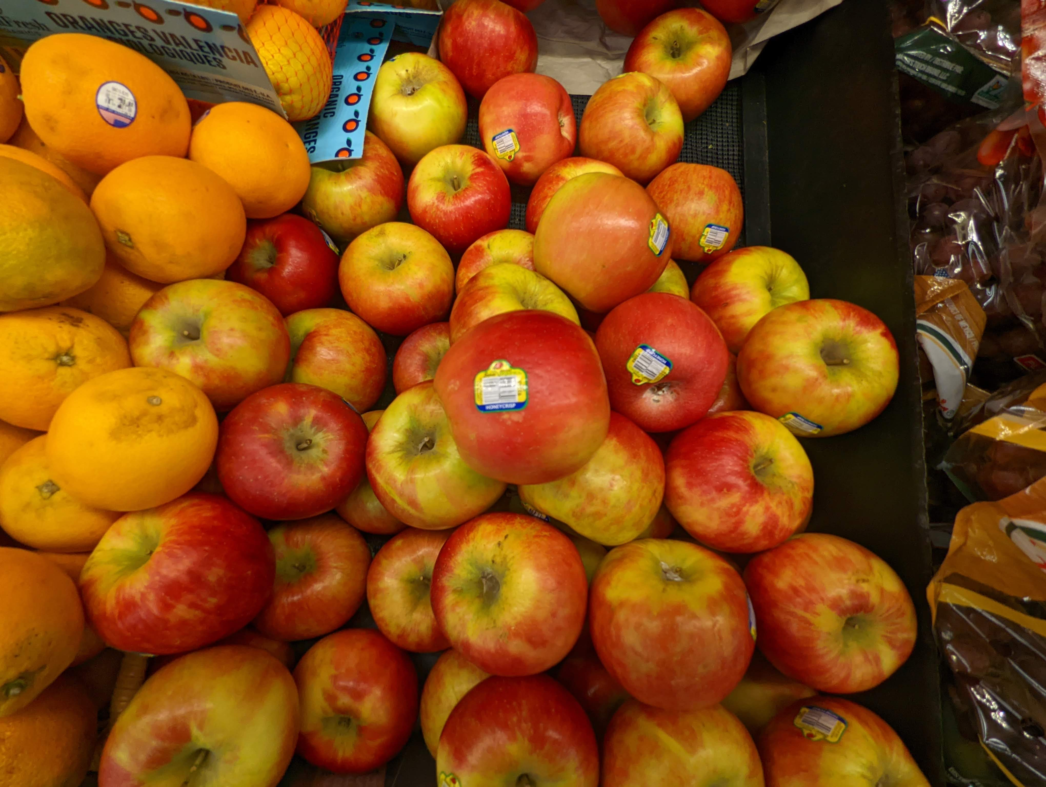

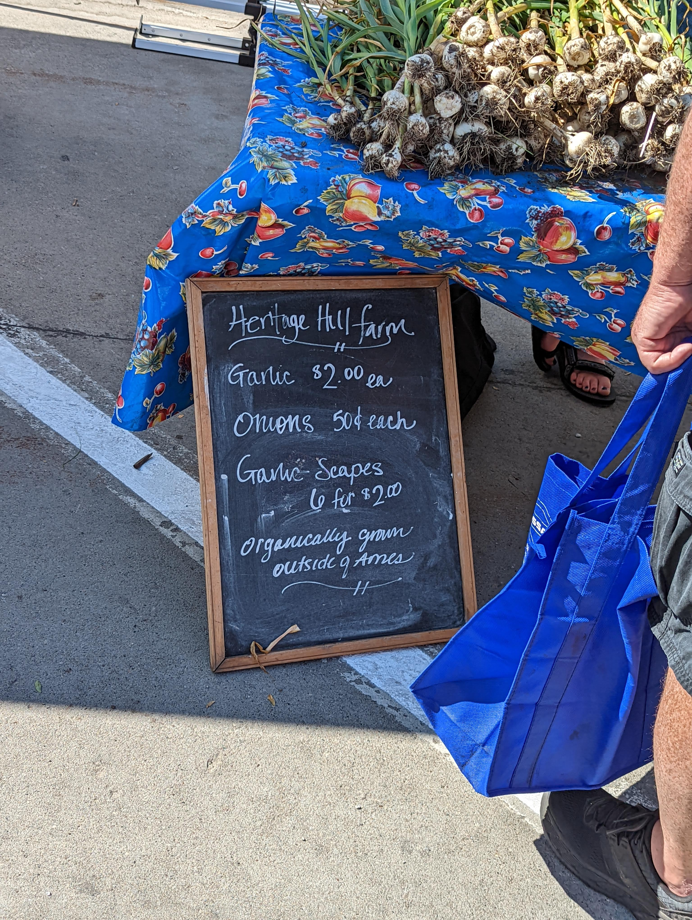
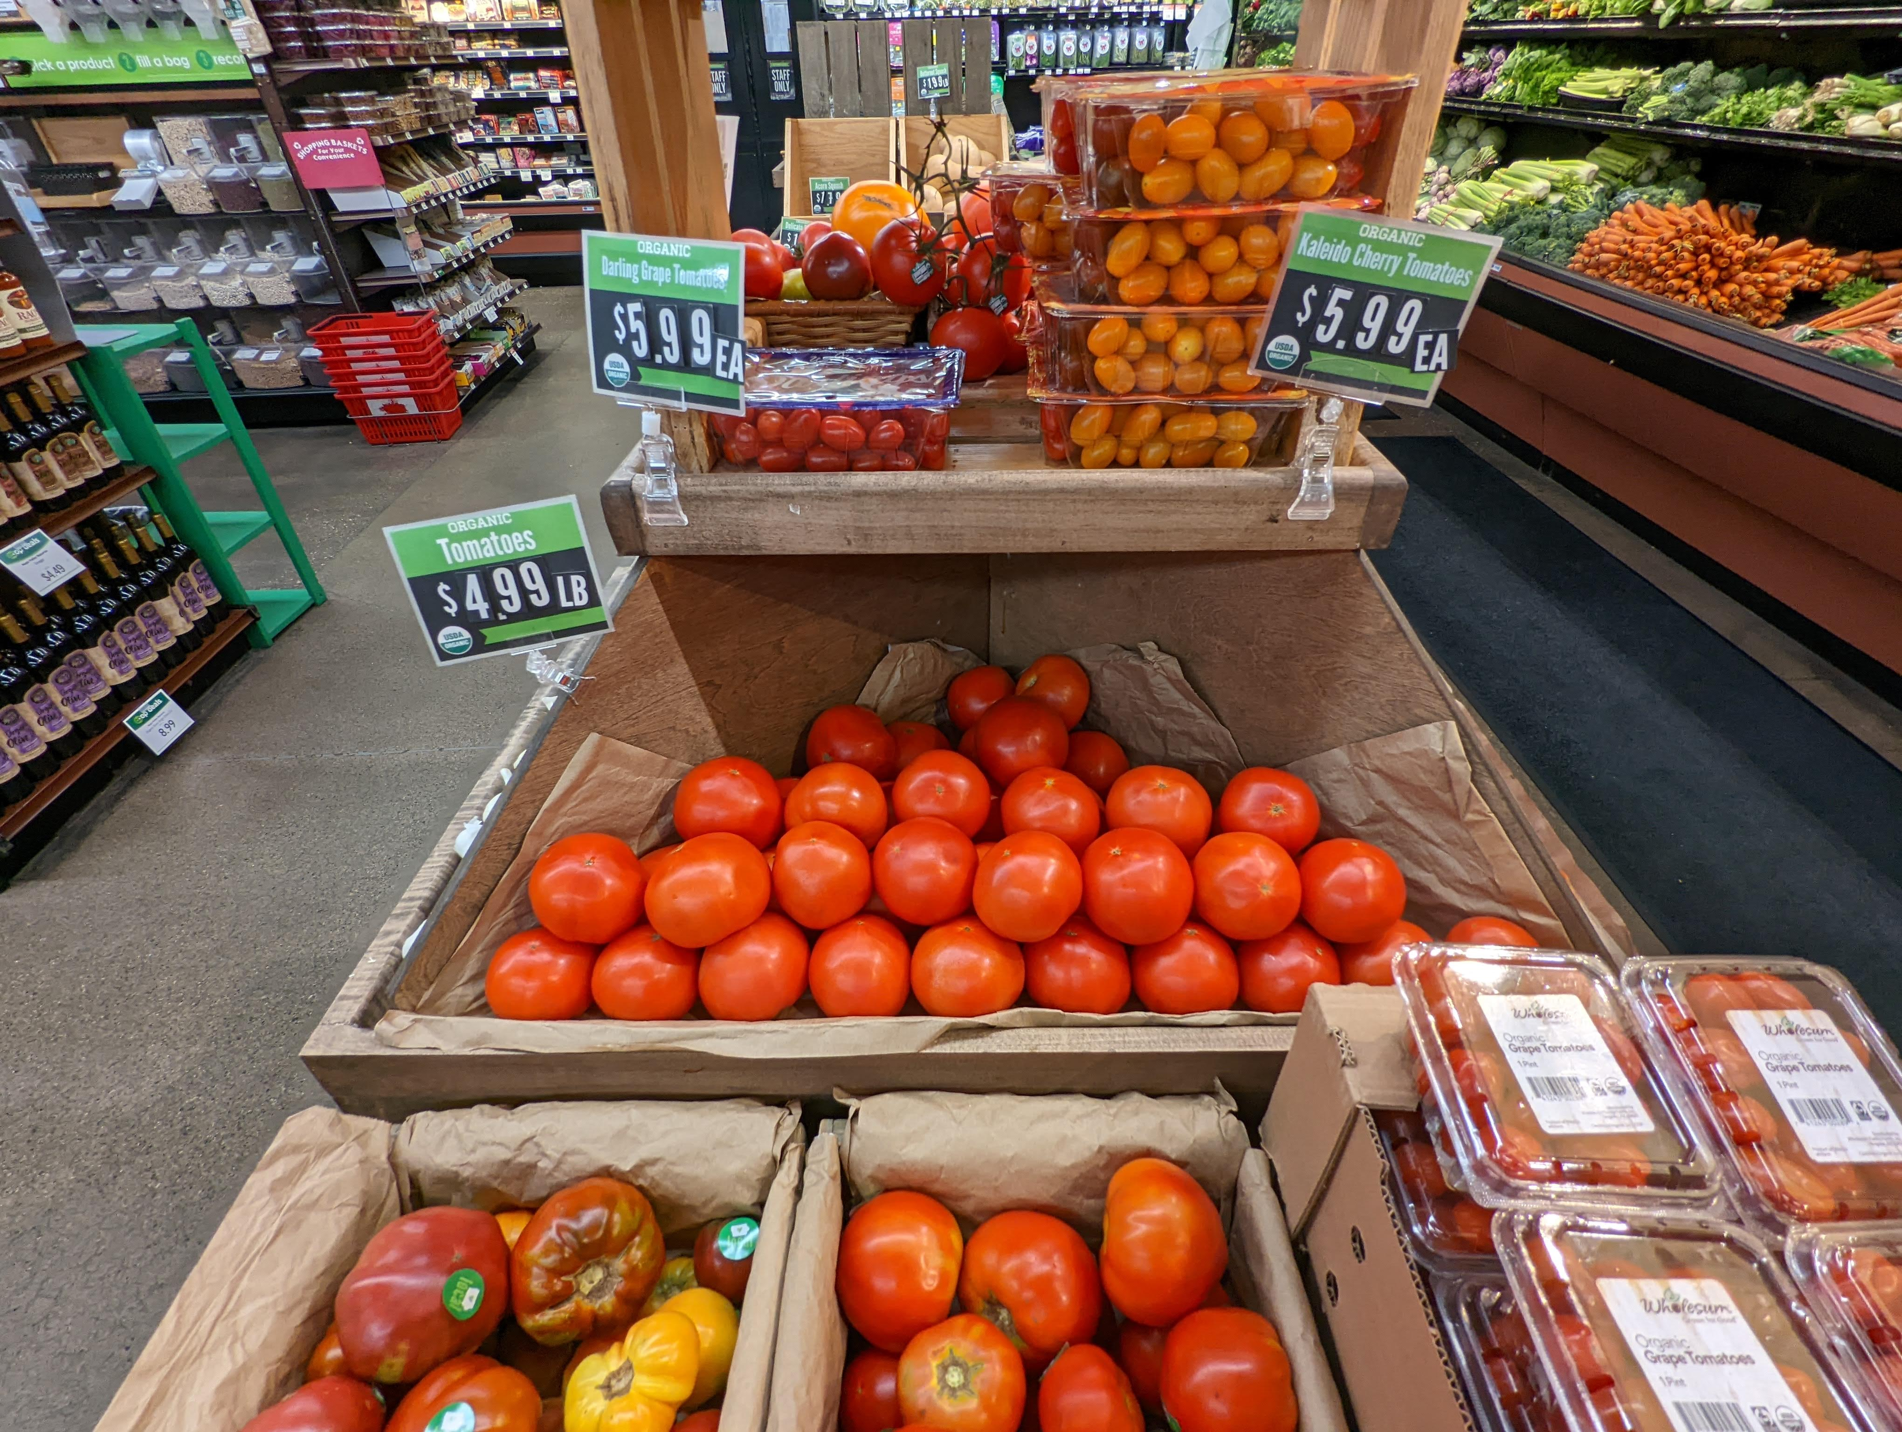

Wholesale Local Food Benchmarking
Project Advisor: Adisak Sukul
Graduate Fellow: Muskan Tantia
Interns: Maxwell Skinner, Nabil Idris, Nayha Hussain

Slide 2


Slide 3

Develop a process that provides more localized and up to date information on regional food systems and prices around local products Background
Background
The Iowa State Farm Food and Enterprise Development (FEED) is frequently asked for benchmarks on pricing of products both in retail and wholesale spaces
There is a need for additional research on the potential sales point for wholesale products when many of the producers are operating in direct-to-consumer retail spaces
While data is available from the AMS and USDA (including the Agricultural Census), there is limited aggregation of sales for these products at the local level
Data from these sources will allow for a comparison then could lead to average price points and benchmarks for local and regional farms and food hubs
Objective
Outcome
Data Discovery: Investigate the possibility of scraping data
Use Google Trends to identify potential key products by terms being searched
Narrowing down the exact products
Compare values of collected data with USDA to determine if this helps in better decision making
Identify potential aspects that could be automated for future data collection
Investigate potential use of AI to identify impacts to local food markets. For example, weather impacts
Used Google Trends to select the top 5 commodities
Apple
Strawberries
Pears
Tomatoes
Green Peppers
Compared the difference between USDA Vs local/Grocery/Food hubs price data
Forecasted the prices and the most important variables affecting the prices using weather and economic factors
End-to-end data automation process created for data collection (web scraping scheduler)

Slide 4
Project Workflow
01
03
05
Data Collection:
Web Scraping/Producer’s Data
Finalizing the Top Commodities + Variety + Unit
Data Automation:
Web Scraping Scheduler
Data Exploration:
Google Trends Vs Price
Comparison:
USDA Vs local/Grocery/Food hubs price
Forecasting Prices using Weather/Economy indicators
02
04
06

Slide 5
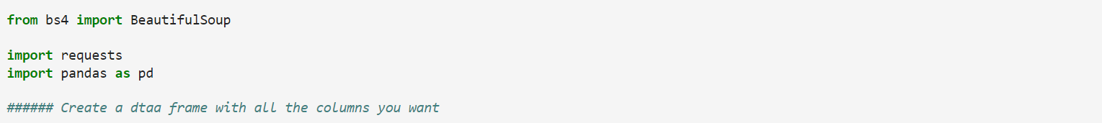
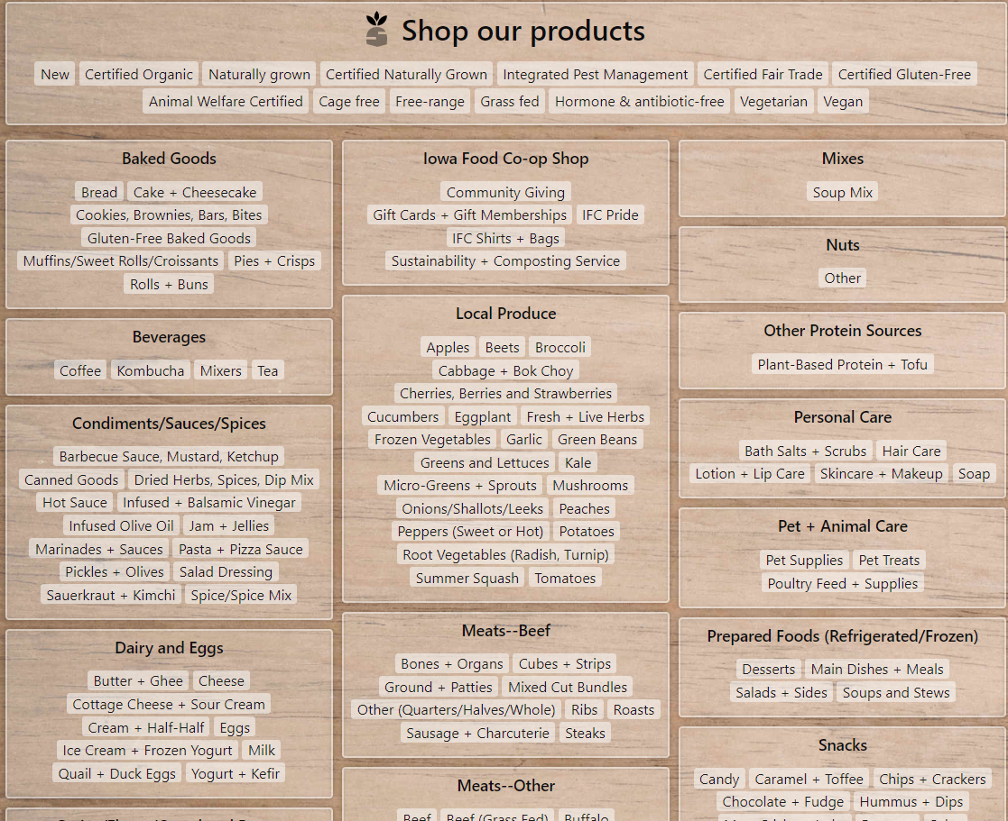
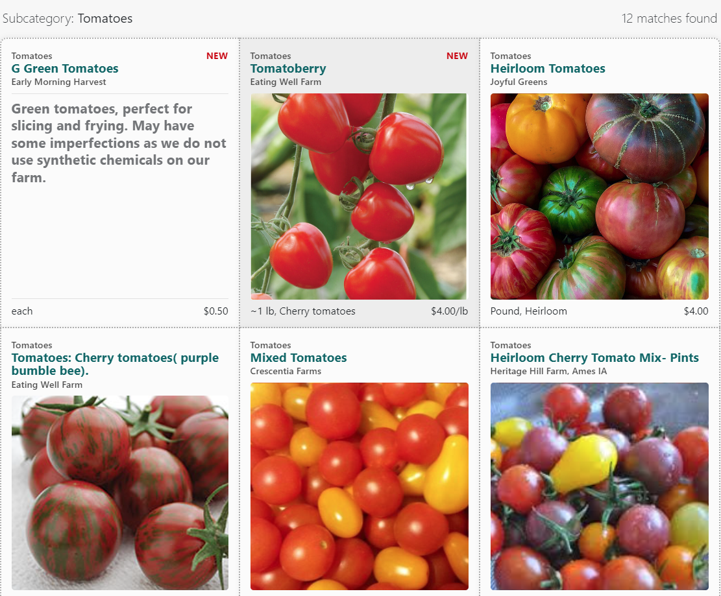
01
Web Scraping
Data Collection
Step 1
Web scraping is the process of gathering information from the Internet.
Some web scraping libraries that can be used:
BeautifulSoup (We used this library)
Selenium
Step 2
Explore website using Chrome Developer Tools
Which web pages contain the data we want?
What are the URLs of those pages?
Example used: https://shop.iowafood.coop/
Notes:
2. Now that you know where information is located, next is to use code libraries to help find it. The libraries we used were selenium, beatiful soup,
And panda. They have functions like findall to make data extraction easier.

Slide 6
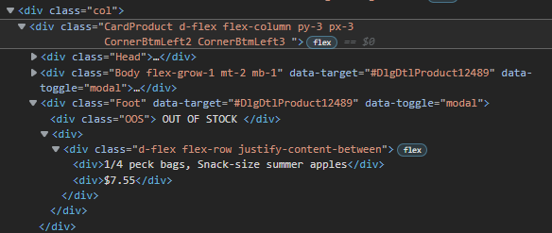
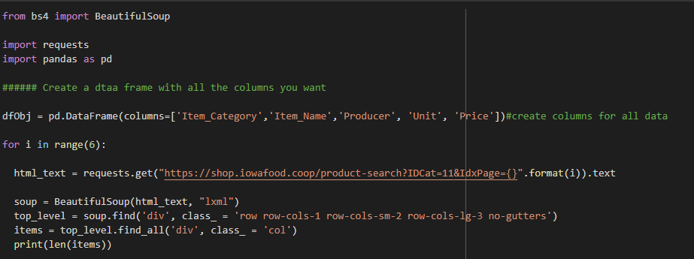
01
Web Scraping
Data Collection
Step 3
HTML is primarily a way to present content to users visually.
Using developer view, look for element that contains the information we need. For example ('div class =…')
There are different types of HTTP requests. We’ll use one of the most common and simple method: the GET request.
Use the requests package to send a GET request and assign the returned response object as response.
A status code of 200 represents a successful request. Other codes show that the request has errors, which need more attention before proceeding further.
Notes:
4. Append your data variables, use those variables in your data frame, and save your data frame into excel. One way we have improved web scraping is by adding a python scheduler. This scheduler will periodically scrape the websites for data to create a log of historical prices (since prices and commodties available on these websites do change.)

Slide 7
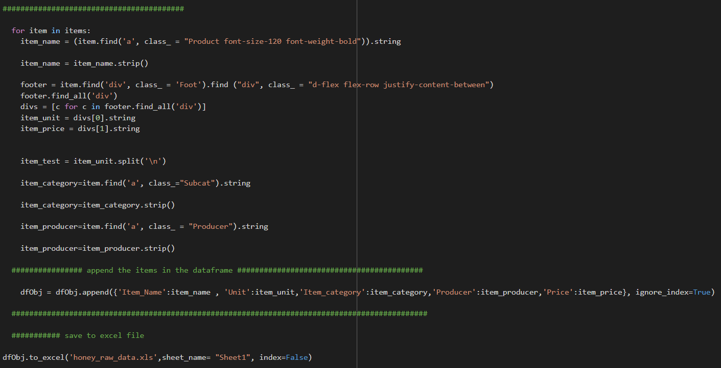
01
Web Scraping
Data Collection
Step 4
Parse the HTML doc with BeautifulSoup
Create a loop to search for the data we need using find()/find_all()
Now that we have all the data it’s better to transform them into pandas data frames. While this step is optional, it’s more convenient for analysis in Python.
Save the data frame to a csv file.
Notes:
3. Next is to create a data frame where you can store you new find extracted data. Most likely your data is spread across multiple html pages so a simple
Loop to iterate through the pages is good.

Slide 8
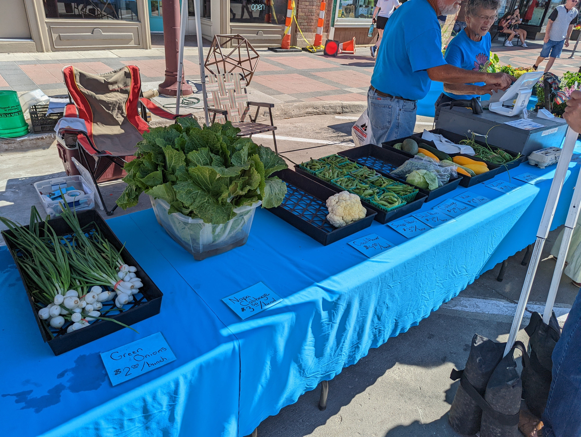
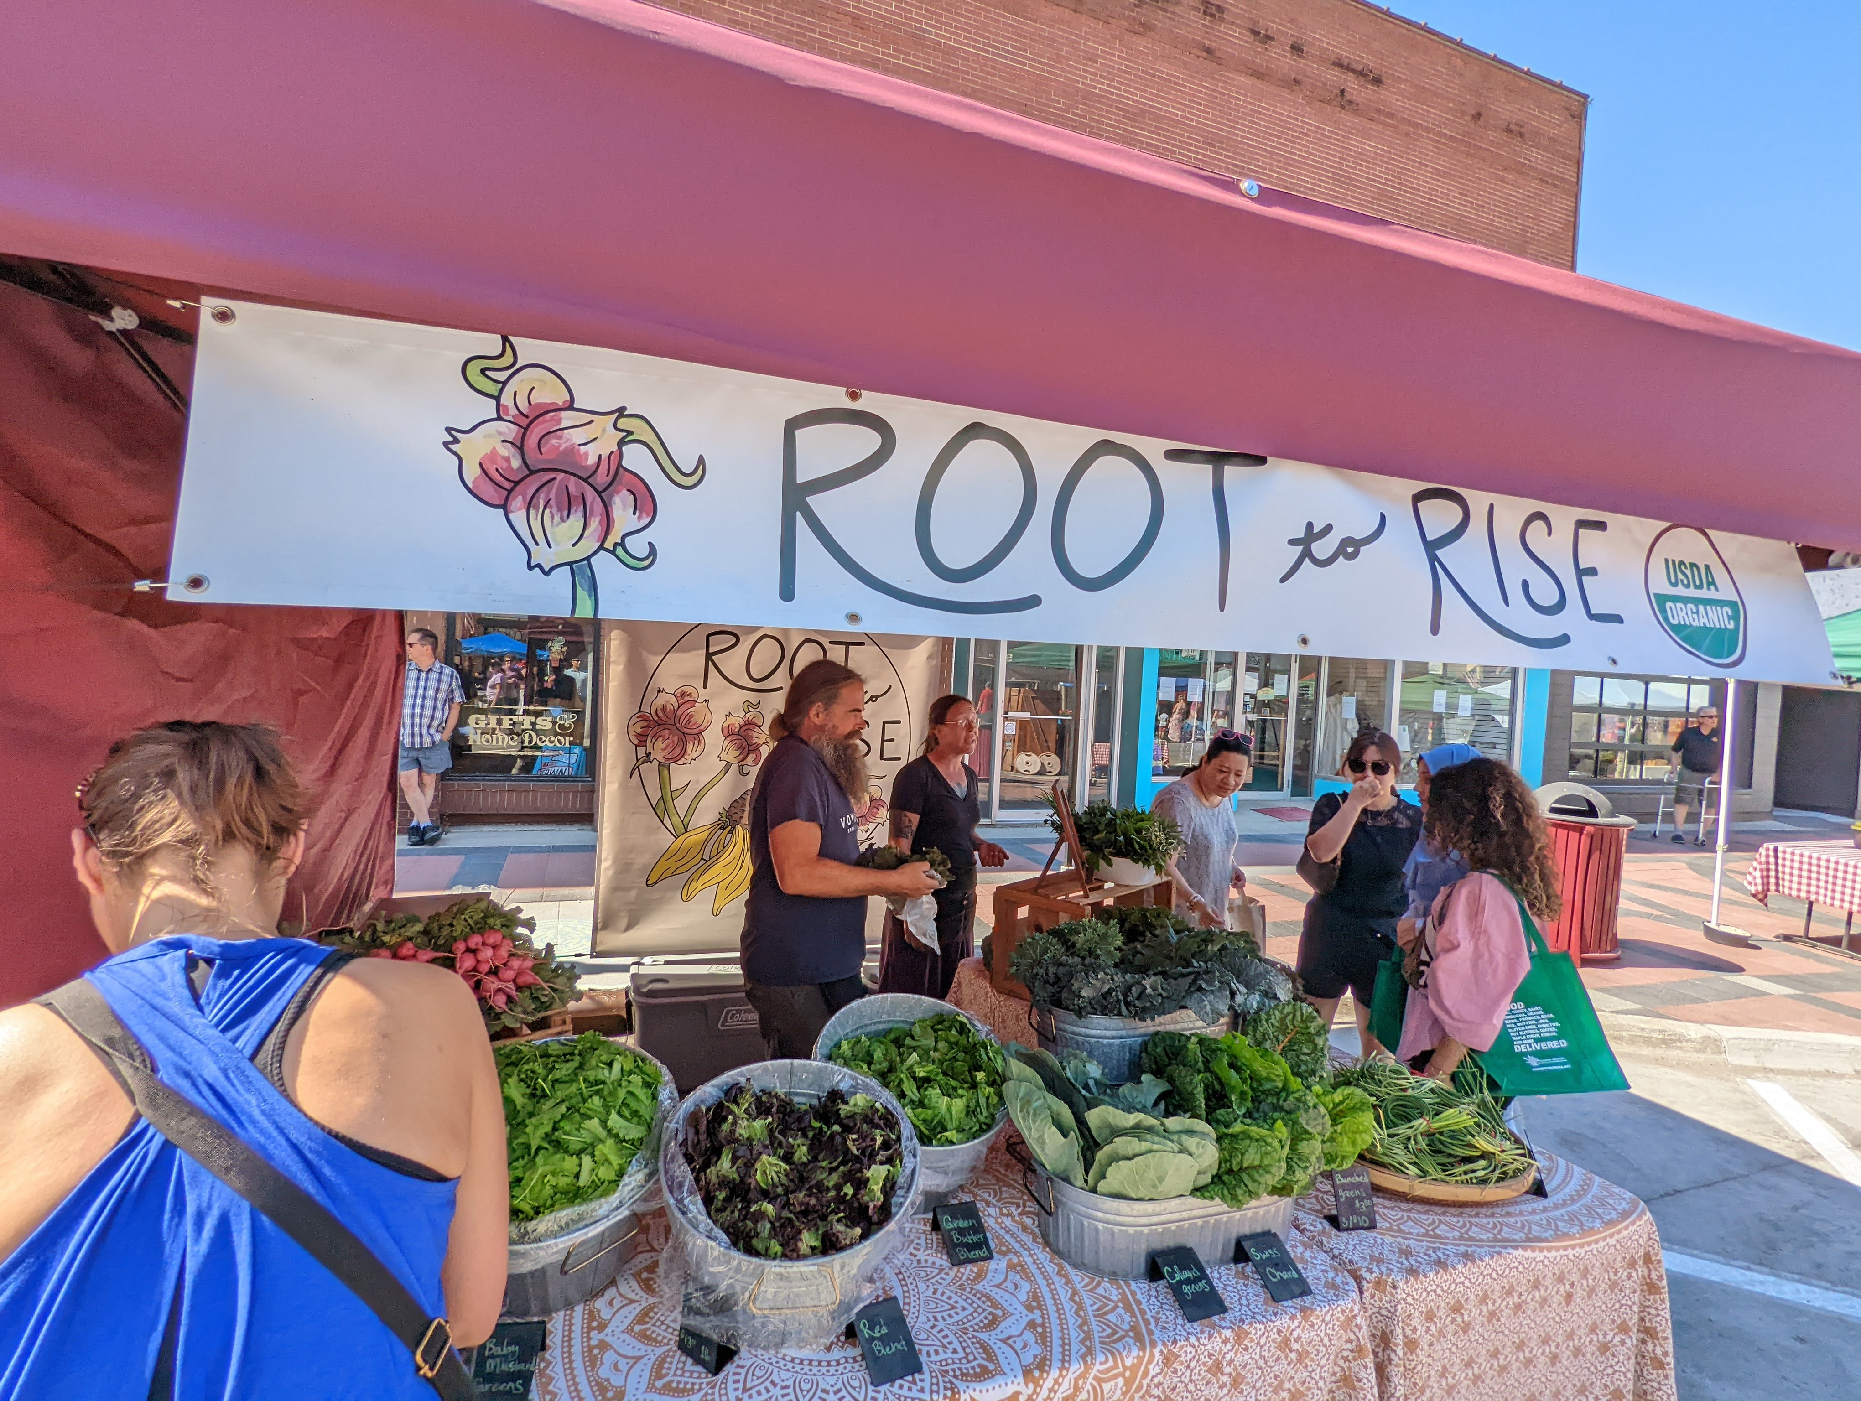
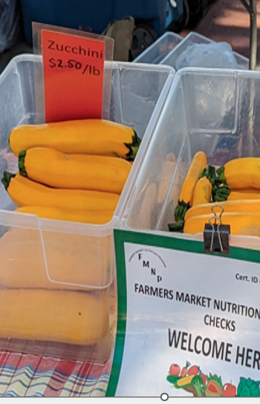
01
Pictures from Ames Farmer’s market
Data Collection
Physically attended Farmer's Market to collect local food prices
Conversations with farmers further confirmed why this research is necessary
Notes:
The next way we collected data was through field work. We went to farmers market in Des Moines and Ames and took pictures of prices we saw and also asked farmers how the determine the price of their products. Their responses further confirmed why this research is so important. Local farmers do not have a benchmark when it comes to pricing. Most responses were they just look at what others are pricing or try utilizing USDA data which is not reflective of local economy. Many farmers also do not keep extensive files on prices and change in prices (inflation). This data was a good initial benchmark. In the future, we are looking of ways to gather this information more efficently. One idea we have is to make an excel template form and send to farmers to fill out.

Slide 9
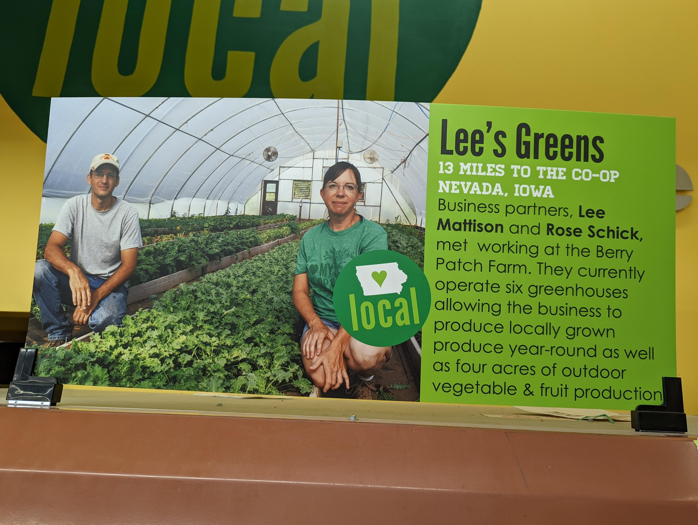
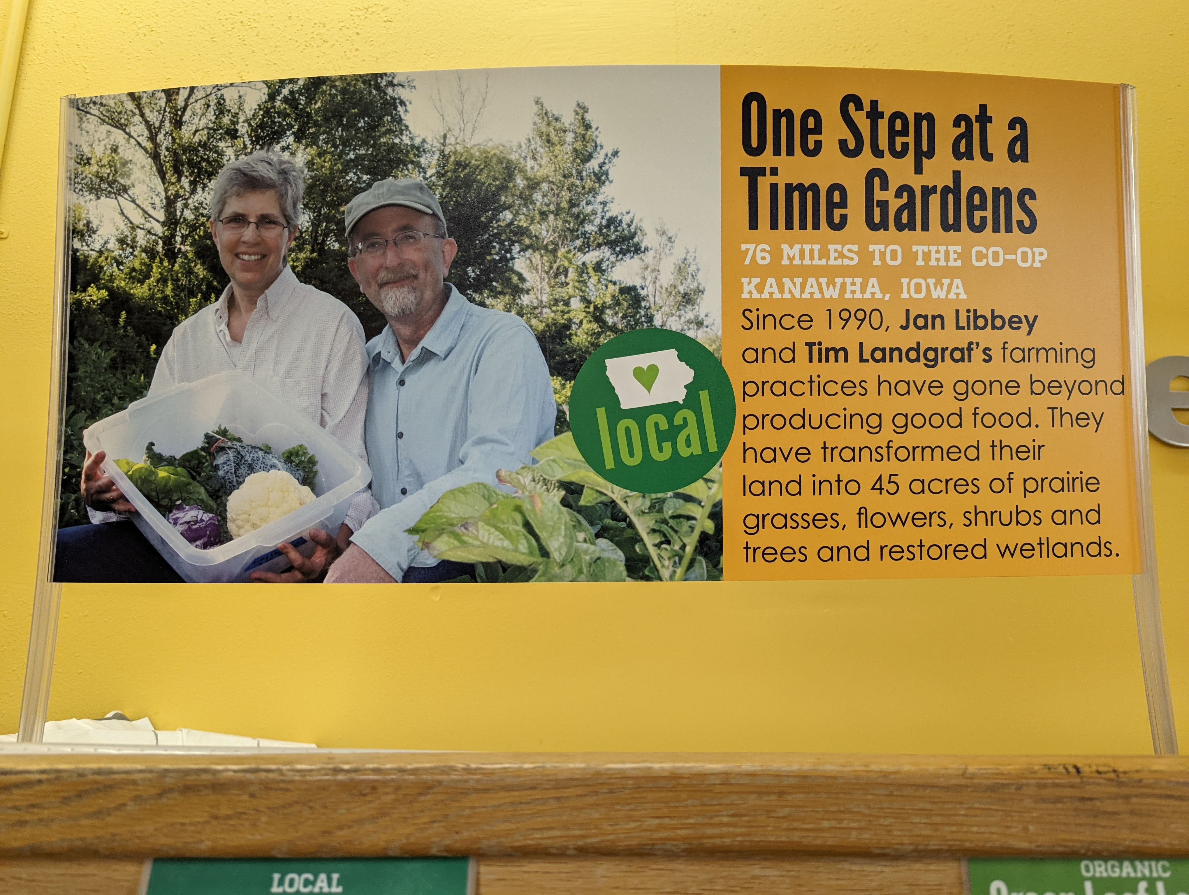
01
Producers (Email/Calls)
Data Collection
Called and Emailed local Iowa farmers and asked about their selling prices
The Price is set in the beginning of the year or in the middle but just once a year
Notes:
Our last method of data collection was cold calls and emails. We then cold call and email them about wholesale prices of their local products. We got some valuable insights such as farmers usually review prices once or twice a year (not changing frequently). While we were able to get some data One issue with this method is the data is sporadic. One farmer might produce 3 out of the 5 commodities while another might produce one. Like mentioned beforehand, many do not keep historical price records for many years (most keep 1-2 years record). Overall this method was a little time consuming and not very comprehensive data that we need for analysis and AI and ML.

Slide 10
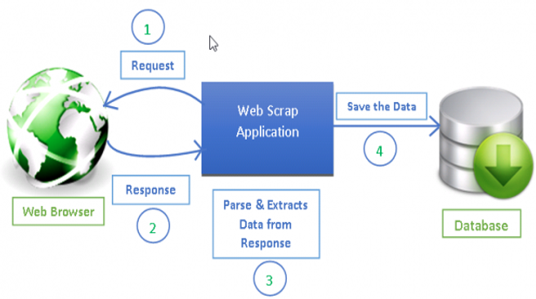
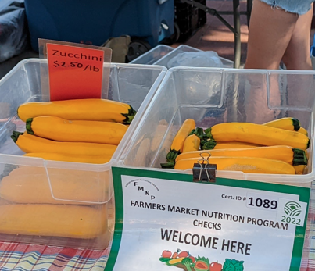
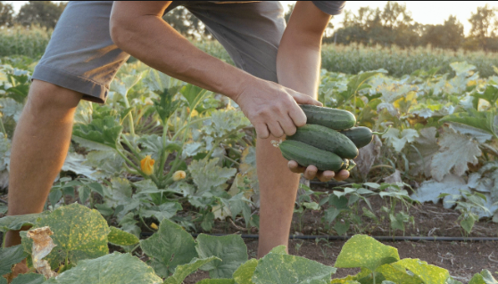

01
Data Collection Flowchart
Data Collection
Diagram of all the data collection methods we used for this project
Online Grocery sites(Walmart/Hy-Vee)
Pictures from farmer’s market
Producers
Web Scraping
Manually extracted the prices
Sent email to producers
Raw Data
Notes:
So here is a diagram of all the data collection methods we have used to form our data base

Slide 11
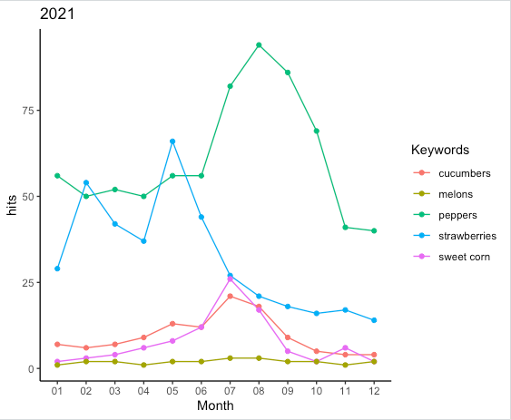
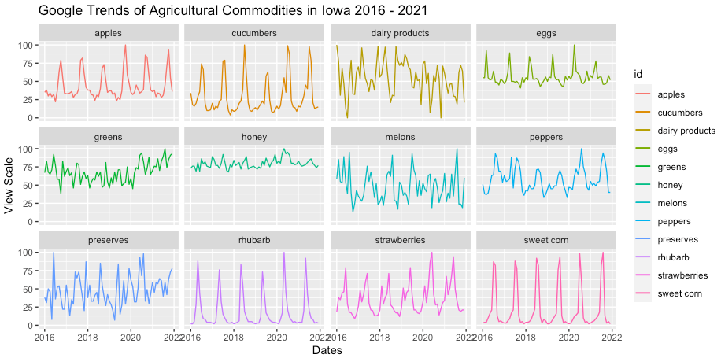
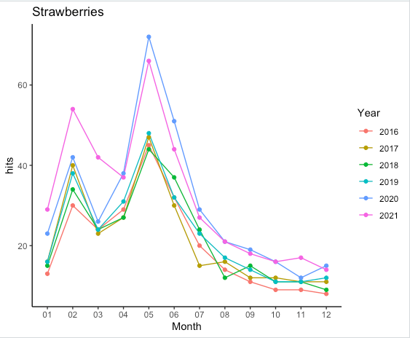
02
02
Google hits by search for products over years
Data Exploration
Google Trends data observation of produce keywords
Google Trends is a tool providing Google search historical data
Peak for peppers
COVID years

Slide 12
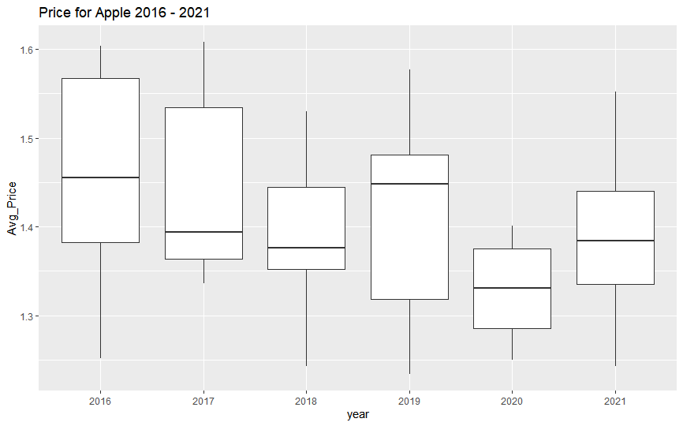
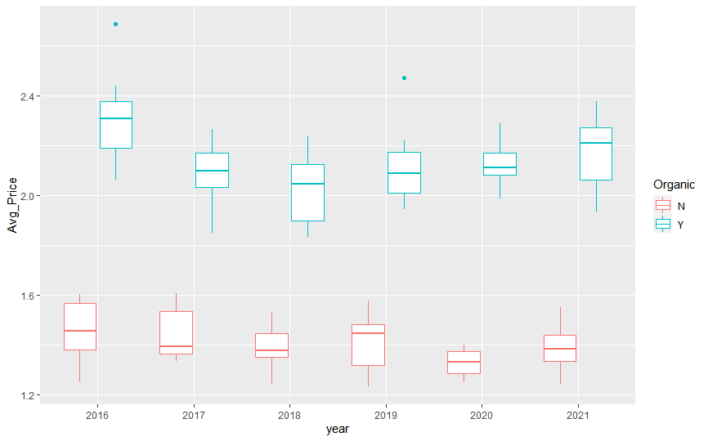
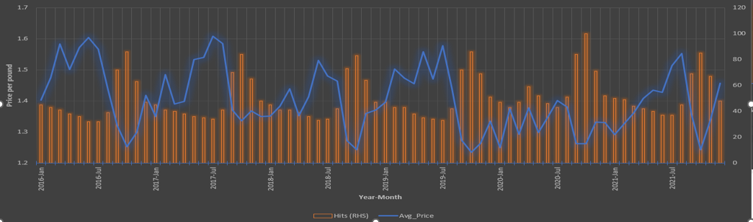
02
02
Apple Price Trend over Years
Data Exploration
Data Exploration
Data exploration of Apple prices visualized in different ways
Organic/Non-Organic Apple prices
Google Search Hits vs. Apple prices(This shows interest over time comparison to price)

Slide 13
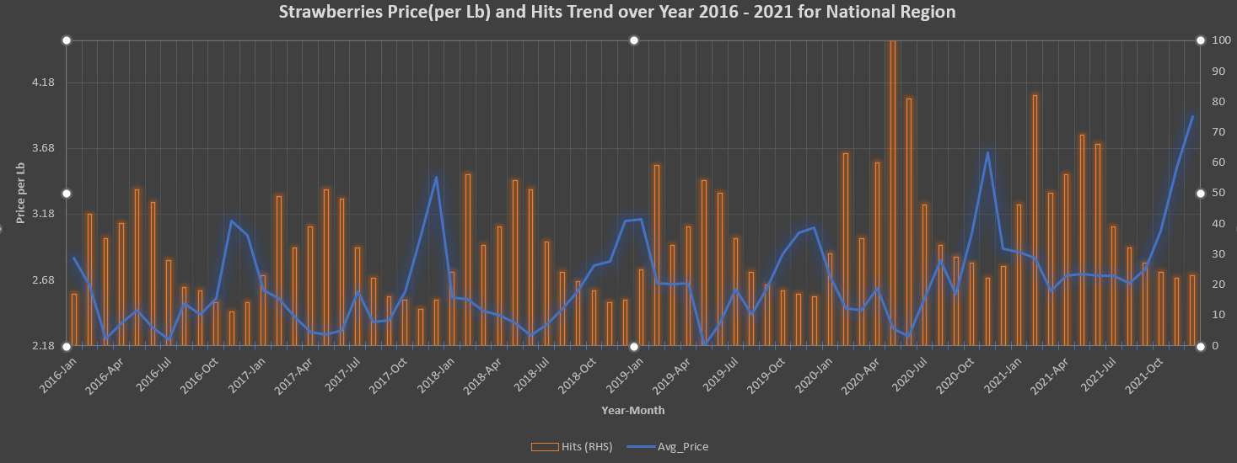
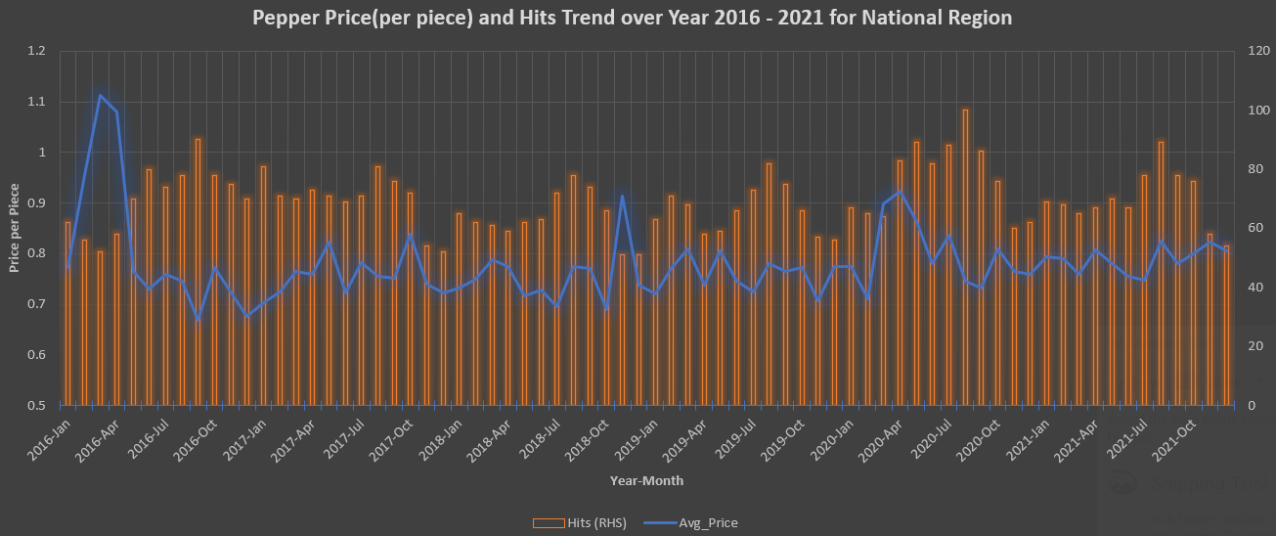
02
02
Low Price when Google Searches are High for Strawberries and Green Pepper
Data Exploration
Data Exploration
Negative correlation between search trends and prices
Green Pepper Prices do not show much variation over years

Slide 14
03
Finalizing the Top Commodities
Prioritize
Select Top Products by Google Trends
Example: Apples, Corn, Cucumbers, Strawberries etc. by Hits
Filter out Products by Area(in acres) for Iowa
Select variety/unit by data availability
Example: Apples have multiple variety like Fuji, Gala, Red Delicious
Criteria for Top 5 selection
Final Products
1. Apple (Red Delicious)
2. Strawberries
3. Pears
4. Tomatoes (Heirloom)
5. Green Peppers
Select Top Products by Google Trends
Example: Apples, Corn, Cucumbers, Strawberries etc. by Hits

Slide 15
04
Comparison: USDA Vs local/Grocery/Food hubs price
Compare
MARKETING CHANNEL FOR CONSUMER PRODUCTS
DIRECT CHANNEL
WHOLESALE CHANNEL
RETAIL CHANNEL
PRODUCER
PRODUCER
PRODUCER
CONSUMERS
WHOLESALER OR DISTRIBUTOR (optional)
WHOLESALER OR DISTRIBUTOR
RETAIL
CONSUMERS

Slide 16
04
Apple(Red Delicious) Non-Organic Price FY 2021
Compare
Wholesale price
Retail price
Grower price
National source
National source
WALMART
(Supermarket National)
$1.29/lb
SYSCO
(Iowa Local Restaurant)
$1.07/lb
USDA (National) $0.61/lb
USDA (Midwest)
$1.20/lb
Direct to consumer's price
Local source
FARMER’S MARKET (Iowa)
N/A
Wholesale price
Retail price
WHEATSFIELD CO-OP
(Iowa)
$0.75/lb
IOWA FOOD CO-OP
(Iowa)
$1.3/lb
Local source
Local source
ISU DINNING
(Institution price)
$0.72/lb
WHEATSFIELD CO-OP
(Iowa)
$2/lb
Grower price - price the grower (ex- farmer) receives (https://www.ers.usda.gov/data-products/fruit-and-tree-nuts-data/fruit-and-tree-nuts-yearbook-tables/
Wholesale price - price received by the wholesaler if there is one between the grower and the retailer
Retail price - price received by the store or retail outlet Source: (Retailing and Wholesaling SME) - Anne Byrne (anne.byrne@usda.gov)
Farmer’s market price gathered from Ames Farmer's Market
Notes:
For all 5 commodities, we created a framework describing the average price, some are at a national and local price, for example, grower price the farmers receive, than it can go to wholesale price and this demonstrates price markups and how it shitfts
Multiple sources, we scraped or directly from producers
Explain the data sources, coop vs retail
Be decriptive for the first one
Now wholesaleers can sell to national or to local
These prices are average price for 2021
We took average from our limited data
Disparity between prices

Slide 17
04
Tomato (Heirloom) Non-Organic Price FY 2021
Compare
Wholesale price
Retail price
Grower price
National source
National source
WALMART
(Supermarket National)
$1.85/lb
SYSCO
(Iowa Local Restaurant)
$2.60/lb
USDA (National) $0.57/lb
USDA (Midwest)
$2.86/lb
Direct to consumer's price
Local source
FARMER’S MARKET (Iowa)
$4.00/lb
Wholesale price
Retail price
WHEATSFIELD CO-OP
(Iowa)
$2.55/lb
IOWA FOOD CO-OP
(Iowa)
$1.52/lb
Local source
Local source
ISU DINNING
(Institution price)
$0.83/lb
WHEATSFIELD CO-OP
(Iowa)
$4.99/lb
GLOBAL GREENS
(CSA)
$2.95/lb
Grower price - price the grower (ex- farmer) receives (https://www.ers.usda.gov/data-products/fruit-and-tree-nuts-data/fruit-and-tree-nuts-yearbook-tables/
Wholesale price - price received by the wholesaler if there is one between the grower and the retailer
Retail price - price received by the store or retail outlet Source: (Retailing and Wholesaling SME) - Anne Byrne (anne.byrne@usda.gov)
Farmer’s market price gathered from Ames Farmer's Market
17
Notes:
Tomoto grower price is very less but retaail price is high
Farmers market vegtable market
Farmrs follow integrated pest management technique, they follow best practice

Slide 18
04
04
Fresh Strawberries Non-Organic Price FY 2021
Fresh Strawberries Non-Organic Price FY 2021
Compare
Compare
Wholesale price
Retail price
Grower price
National source
Grower price
National source
WALMART
(Supermarket National)
$2.21/lb
SYSCO
(Iowa Local Restaurant)
$2.16/lb
USDA (National) $1.82/lb
USDA (Midwest)
$2.66/lb
Direct to consumer's price
Local source
FARMER’S MARKET (Iowa)
N/A
Wholesale price
Retail price
WHEATSFIELD CO-OP
(Iowa)
$3.75/lb
IOWA FOOD CO-OP
(Iowa)
$5.76/lb
Local source
Local source
ISU DINNING
(Institution price)
$2.00/lb
WHEATSFIELD CO-OP
(Iowa)
$4.99/lb
Grower price - price the grower (ex- farmer) receives (https://www.ers.usda.gov/data-products/fruit-and-tree-nuts-data/fruit-and-tree-nuts-yearbook-tables/
Wholesale price - price received by the wholesaler if there is one between the grower and the retailer
Retail price - price received by the store or retail outlet Source: (Retailing and Wholesaling SME) - Anne Byrne (anne.byrne@usda.gov)
Farmer’s market price gathered from Ames Farmer's Market
18

Slide 19
04
Fresh Pears Non-Organic Price FY 2021
Compare
Wholesale price
Retail price
Grower price
National source
National source
WALMART
(Supermarket National)
$0.78/lb
SYSCO
(Iowa Local Restaurant)
$0.94/lb
USDA (National) $0.28/lb
USDA (Midwest)
$1.3/lb
Direct to consumer's price
Local source
IOWA FOOD CO-OP
(Iowa)
$1.70/lb
Wholesale price
Retail price
WHEATSFIELD CO-OP
(Iowa)
$2.39/lb
Local source
Local source
ISU DINNING
(Institution price)
$0.50/lb
WHEATSFIELD CO-OP
(Iowa)
$2.99/lb
Grower price - price the grower (ex- farmer) receives (https://www.ers.usda.gov/data-products/fruit-and-tree-nuts-data/fruit-and-tree-nuts-yearbook-tables/
Wholesale price - price received by the wholesaler if there is one between the grower and the retailer
Retail price - price received by the store or retail outlet Source: (Retailing and Wholesaling SME) - Anne Byrne (anne.byrne@usda.gov)
Farmer’s market price gathered from Ames Farmer's Market
19
Notes:
Farmers market to retail column
Add arrows that go from grower price to wholesale to retail
And another from grower to retail
Maybe one big one in the middle
And show avg markup for both

Slide 20
04
Green Pepper Non-Organic Price FY 2021
Compare
Wholesale price
Retail price
Grower price
National source
National source
WALMART
(Supermarket National)
$0.62/ea
SYSCO
(Iowa Local Restaurant)
$1.2/ea
USDA (National) $0.20/ea
USDA (Midwest)
$0.87/ea
Direct to consumer's price
Local source
IOWA FOOD CO-OP
(Iowa)
$0.85/ea
Wholesale price
Retail price
WHEATSFIELD CO-OP
(Iowa)
$1.07/lb
Local source
Local source
FARMER MARKET
(Iowa)
$0.7/ea
ISU DINNING
(Institution price)
$0.46/ea
WHEATSFIELD CO-OP
(Iowa)
$1.4/ea
GLOBAL GREENS
(CSA)
$0.85/ea
Grower price - price the grower (ex- farmer) receives (https://www.ers.usda.gov/data-products/fruit-and-tree-nuts-data/fruit-and-tree-nuts-yearbook-tables/
Wholesale price - price received by the wholesaler if there is one between the grower and the retailer
Retail price - price received by the store or retail outlet Source: (Retailing and Wholesaling SME) - Anne Byrne (anne.byrne@usda.gov)
Farmer’s market price gathered from Ames Farmer's Market
20
Notes:
Farmers market to retail column
Add arrows that go from grower price to wholesale to retail
And another from grower to retail
Maybe one big one in the middle
And show avg markup for both

Slide 21
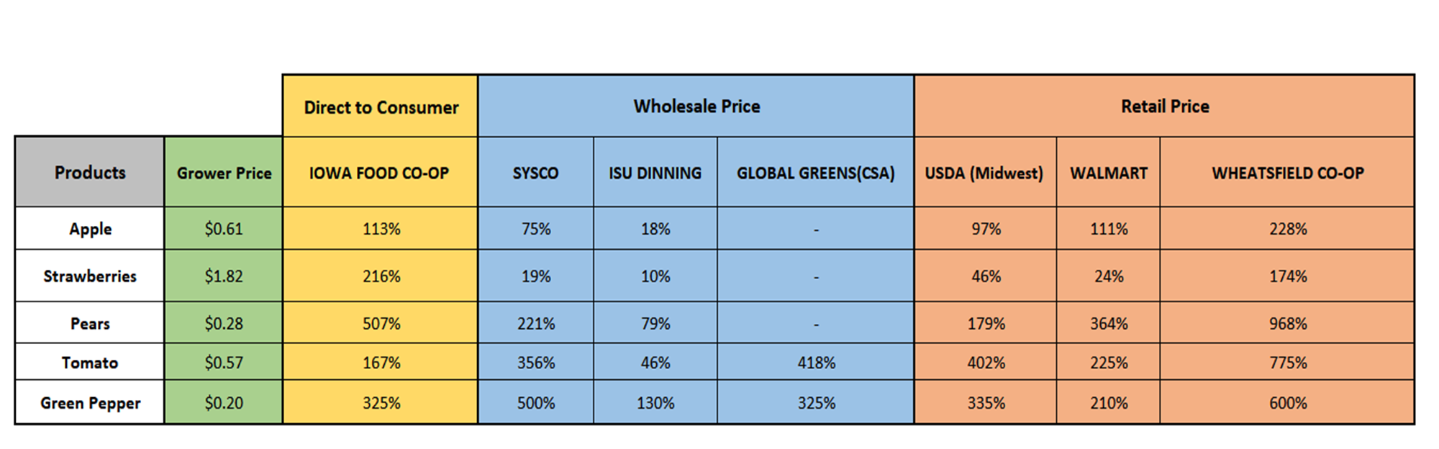
04
Price Markup Percentage compared to Grower Price FY 2021
Compare
Notes:
Average markup from grower price
On this slide gives you a view of percentage increase
Now here is a table showing all data sources, percentage increase in
600% more than farmer price
ISU dining has the lowest markup
Grocery store varies by the commdoities, so cannot accurately make over arching assumptons
Strawberries vs tomoatos

Slide 22
04
Price Trend Over Years for Multiple Data Sources
Compare
Seasonality
Notes:
Here is an example of apple
Orange is grower
Blue is retail
With increase years, the gap between grower price and retail price is increasing year over yesr, meaning farmers are getting less
Why is this happening, lets se in next slide
Walmart didn’t adjust in national economy vs iowa food coop did adjust for covid, one explanation is marketing
Below is another graph which compare the multiple data sources, for example walmart price increase, while iowa food coop has a decrease in price

Slide 23


04
Compare
Where is your money going when you pay $1 for apple? Is the cost really $1?
Farmer’s Price
Retail Price
Farm Share
Marketing Share
Farm Share
Marketing Share
85
15
43
57

Slide 24
04
Compare
Where is your money going when you pay $1 for tomatoes? Is the cost really $1?
Farmer’s Price
Retail Price
Farm
Share
Farm Share
Marketing Share
Marketing Share
69
31
21
79
Notes:
Advocating for farmers buy, get a much larger share to keep

Slide 25
04
Compare
Where is your money going when you pay $1 for strawberries? Is the cost really $1?
Farmer’s Price
Retail Price
Marketing Share
Farm Share
Farm Share
Marketing Share
90
10
62
38

Slide 26
04
Compare
Where is your money going when you pay $1 for pears? Is the cost really $1?
Farmer’s Price
Retail Price
Farm
Share
Farm Share
Marketing Share
Marketing Share
56
44
22
78

Slide 27
04
Compare
Where is your money going when you pay $1 for green peppers? Is the cost really $1?
Farmer’s Price
Retail Price
Farm
Share
Farm Share
Marketing Share
Marketing Share
43
57
23
77

Slide 28
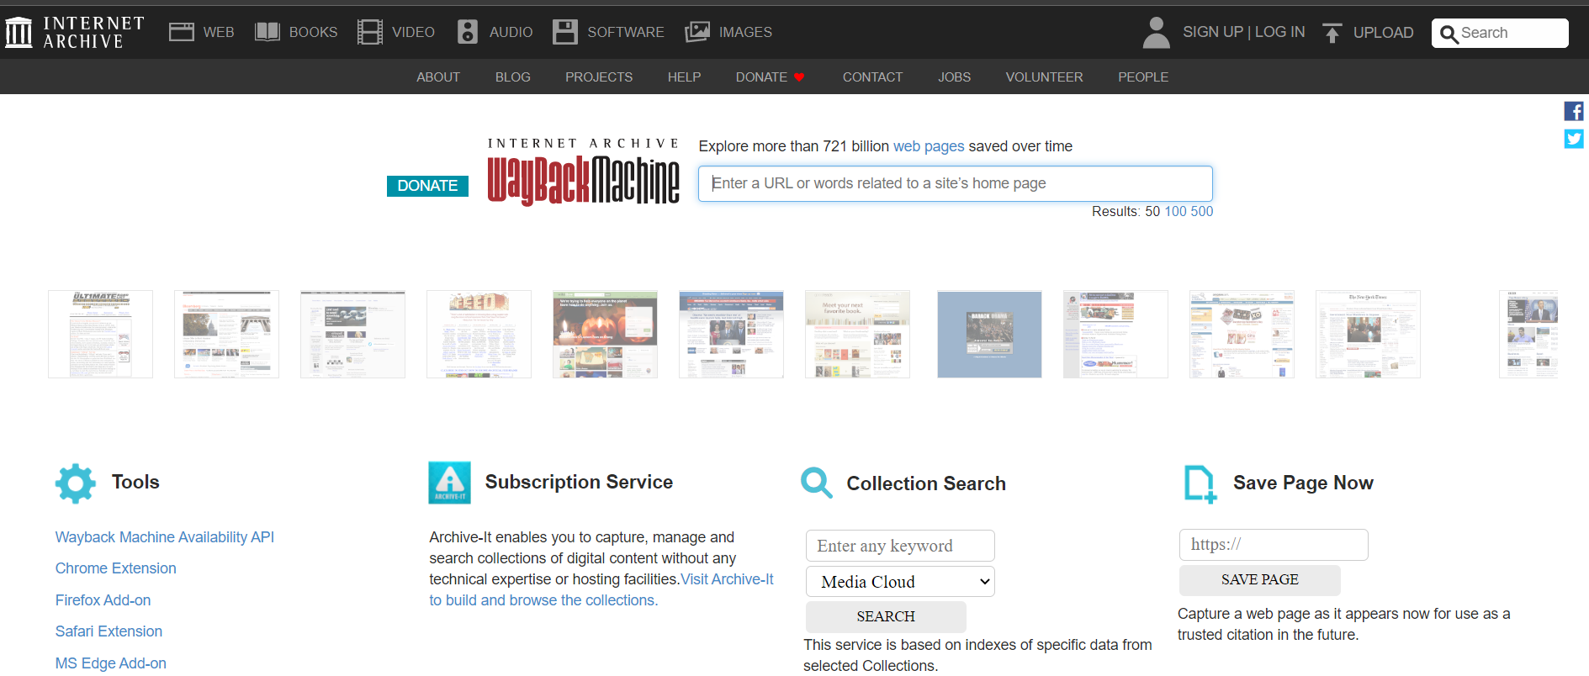
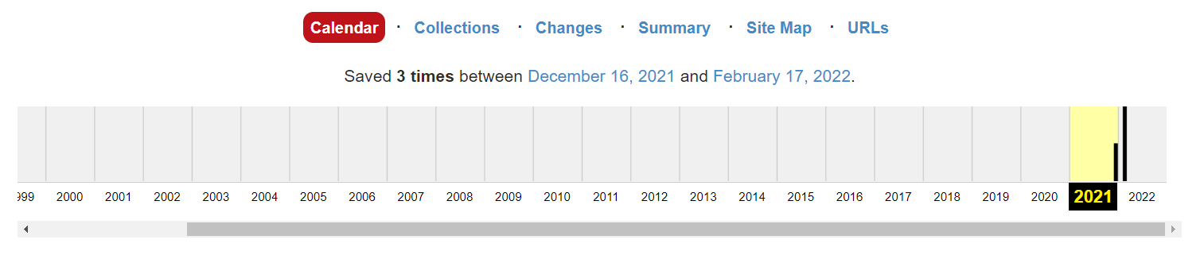
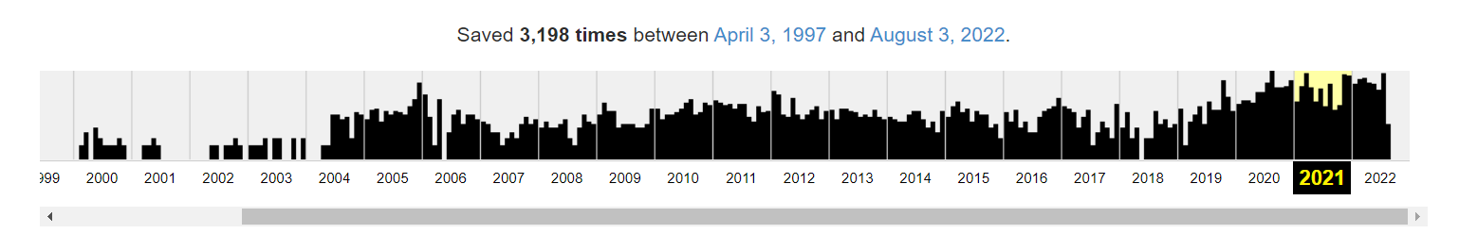
05
The need for automation to collect product prices from archived website data
Data Automation
The Wayback Machine is a digital archive of the World Wide Web founded by the Internet Archive.
Challenges
Not all website data is captured
Does not work with all websites
Example: Iowa Food Coop vs Hyvee
Iowa Food Coop
Hyvee
Notes:
Challenges: Archived website data from wayback machine

Slide 29
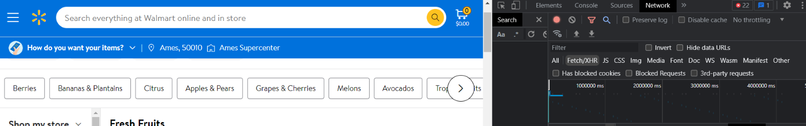
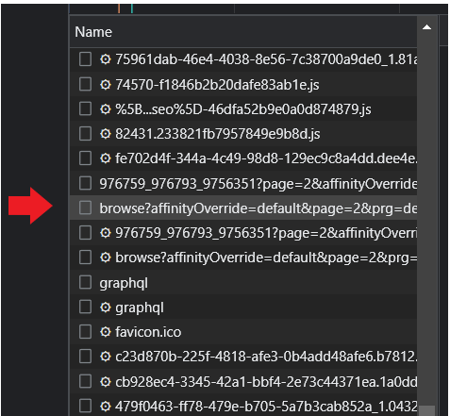
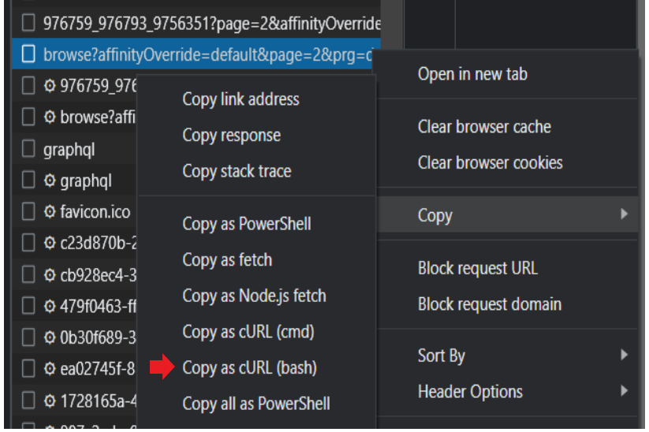
05
How to scrape Walmart product information using Python and Postman API
Data Automation
Steps to get the information from product page using Postman API:
1. Navigate to product page. For example: Walmart.com
2. Using Chrome Developer Tools, select network and select the Fetch/XHR tab
3. Scroll through requests until you find the above name in the list
4. Next, right click the response and select ‘Copy as cURL(bash)’
Notes:
Challenges: Archived website data from wayback machine

Slide 30
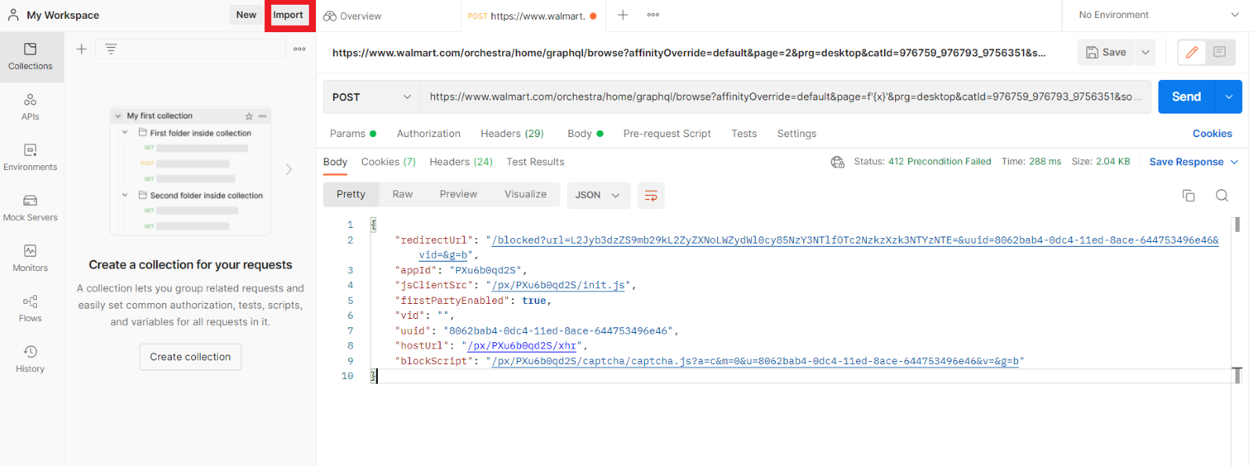
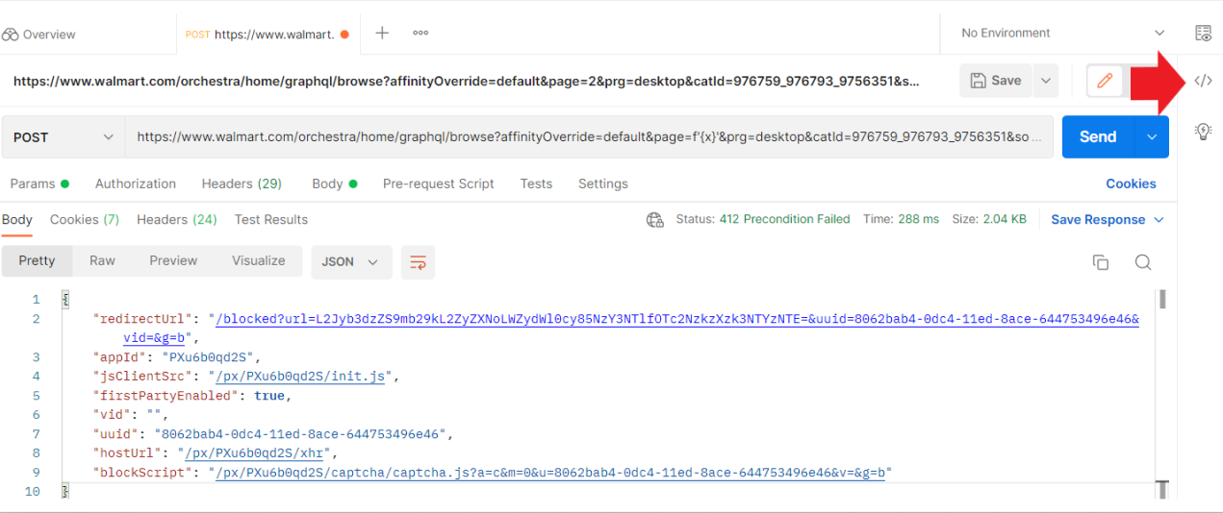
05
How to scrape Walmart product information using Python and Postman API
Data Automation
Workspace in Postman
5. Go to https://www.postman.com/
Sign up for an account (Free to use)
Navigate to your workspace (My Workspace)
Click on ‘Import’, select ‘Raw Text’ and past the cURL in the box and click ‘Continue’ and then ‘Import’
6. Click on the ‘</>’ symbol
Select ‘Python - Requests’ from the Code Snippet drop-down menu.
Copy the code snippet to your code editor.

Slide 31
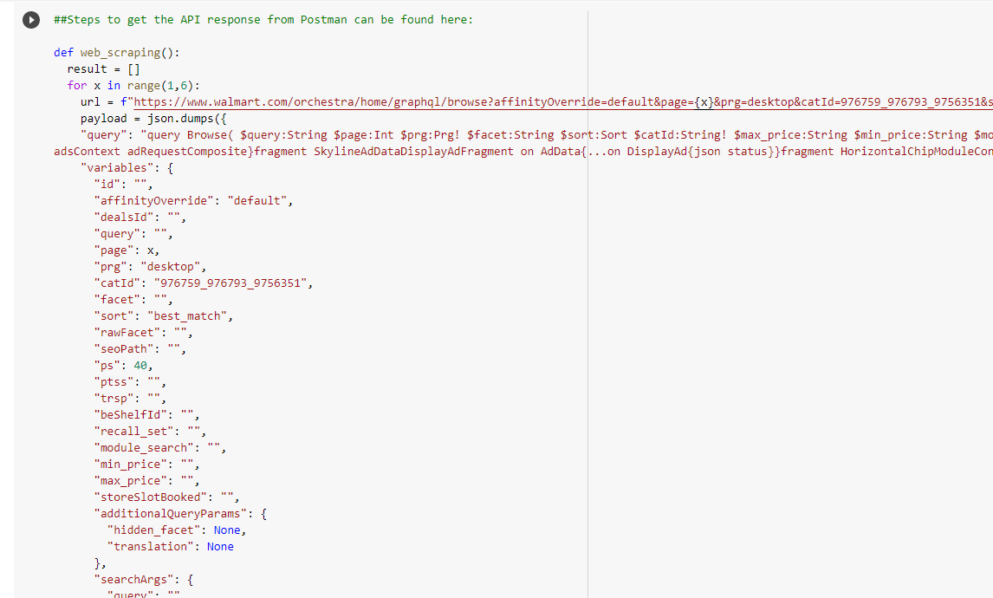
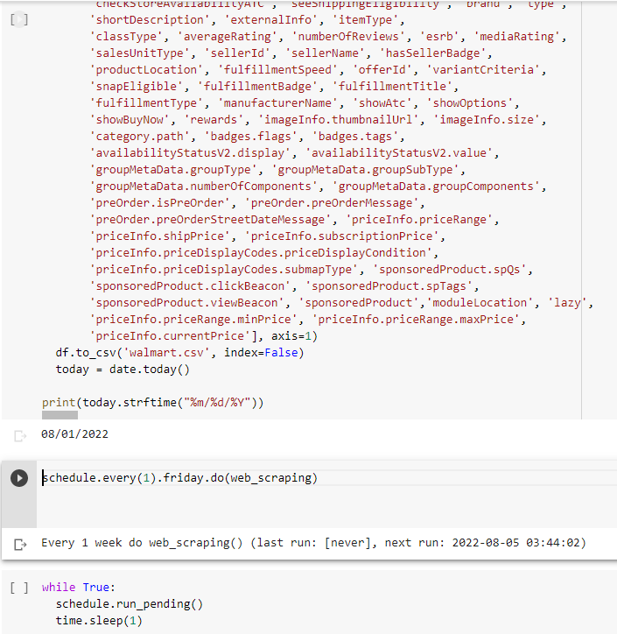
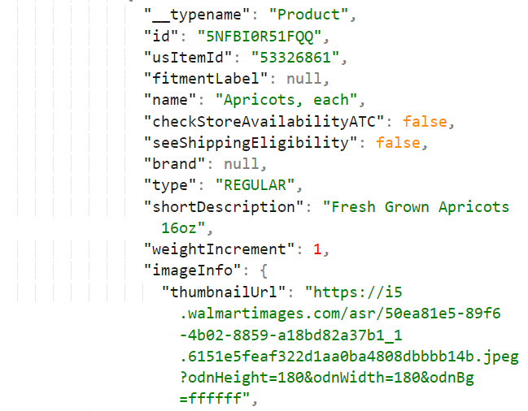
05
Schedule Python Scripts every week/day for Web Scraping
Data Automation
Copy of API response from Postman
Example product information that will be replicated by the API response using Postman
With APIs, you can avoid parsing HTML.
7. Switch to your code editor (using Google Colab in this example)
Information is saved to a csv file.
Script to schedule the web scraping to run at a certain time per day/week

Slide 32
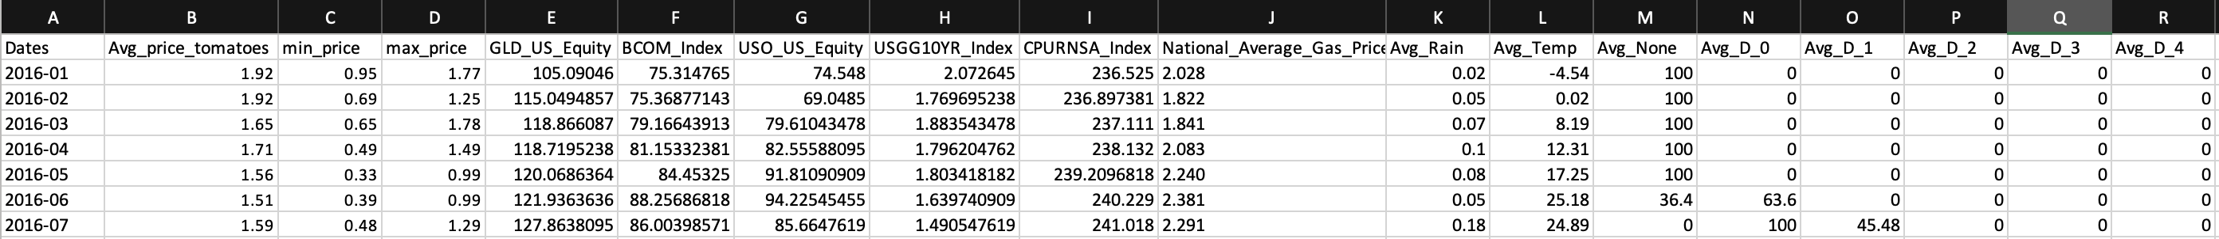
06
AI: Predicting Average Price of a Commodity
Forecasting
Objective:
Utilize machine learning models to predict future commodity prices based on certain indicators
Indicators Used:
Historical USDA retail price data of apples and tomatoes in the Midwest region (USDA Market News)
Historical precipitation and temperature data from ISU mesonet: https://mesonet.agron.iastate.edu/
Drought data in Story County, Iowa (drought.gov)
10 Year US Interest Rate (USO_US_Equity)
Gold Bullion historical price (GLD_US_equity)
Crude oil futures (WTI)
BCOM Index Bloomberg Commodity Index (BCOM_Index)

Slide 33
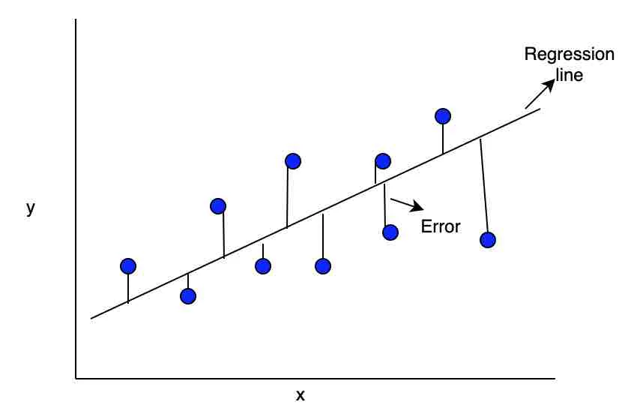
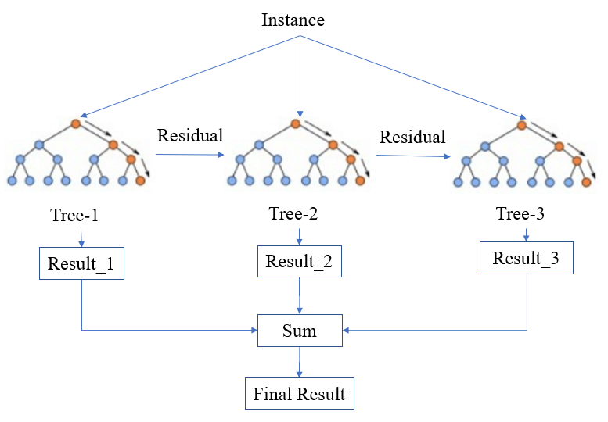
06
How we choose the Machine Learning Model
Forecasting
Linear Regression
Models selection for Price Regression problem: Why we chose these models?
Linear regression
Is a simple model used to estimate the relationship between two quantitative variables.
The modeling speed of linear regression is fast as it does not require complicated calculation.
XGBoost Regressor
The Extreme Gradient Boosting (XGBoost) is an open-source library that provides an efficient and effective implementation of the gradient boosting algorithm.
XGBoost Regressor is designed to be both computationally efficient (e.g. fast to execute) and highly effective.
Simplified structure of XGBoost.
Linear Regression https://www.analyticsvidhya.com/blog/2021/06/25-questions-to-test-your-skills-on-linear-regression-algorithm/
Simplified structure of XGBoost. https://www.researchgate.net/figure/Simplified-structure-of-XGBoost_fig2_348025909
Notes:
XGBoost the Algorithm operates on decision trees, models that construct a graph that examines the input under various “if” statements (vertices in the graph). Whether the “if” condition is satisfied influences the next “if” condition and eventual prediction. XGBoost the Algorithm progressively adds more and more “if” conditions to the decision tree to build a stronger model.
Linear regression is a parametric model: it assumes the target variable can be expressed as a linear combination of the independent variables (plus error). Gradient boosted trees are nonparametric: they will approximate any* function. So xgboost will generally fit training data much better than linear regression, but that also means it is prone to overfitting, and it is less easily interpreted. Either one may end up being better, depending on your data and your needs. In our case, we were looking for a model that had the lowest mean squared error.

Slide 34

06
Observed Metrics
Forecasting
Metrics to measure how good of our Machine Learning Model:​
​
Mean absolute error (MAE) represents the average of the absolute difference between the actual and predicted values in the dataset. It measures the average of the residuals in the dataset (basically, is the absolute difference between the actual or true values and the values that are predicted)​
Mean Squared Error (MSE) represents the average of the squared difference between the original and predicted values in the data set. It measures the variance of the residuals.
Root Mean Squared Error (RMSE) is the square root of Mean Squared error. It measures the standard deviation of residuals​
R- squared (R^2) is the proportion of the variance of a dependent variable that is explained by an independent variable in a regression model. The higher R² of a model, the more the input variables it consist of influence the model output.
Comparison of model performance metrics (Apple)
Comparison of model performance metrics (Tomato)
​ | MAE​ | MSE​ | RMSE​ | R^2​
Linear Regression​ | 0.166919 | 0.042265​ | 0.205586 | -0.097141
XGBoost​ | 0.162083 | 0.033367 | 0.182665 | 0.133858
​ | MAE​ | MSE​ | RMSE​ | R^2​
Linear Regression​ | 0.133622 | 0.025319 | 0.159120 | 0.257504
XGBoost​ | 0.138326 | 0.028487 | 0.168782 | 0.164596
Comparison of model performance metrics (Apple)
Comparison of model performance metrics (Tomato)
The XGBoost model has better scores on all metrics.

Slide 35
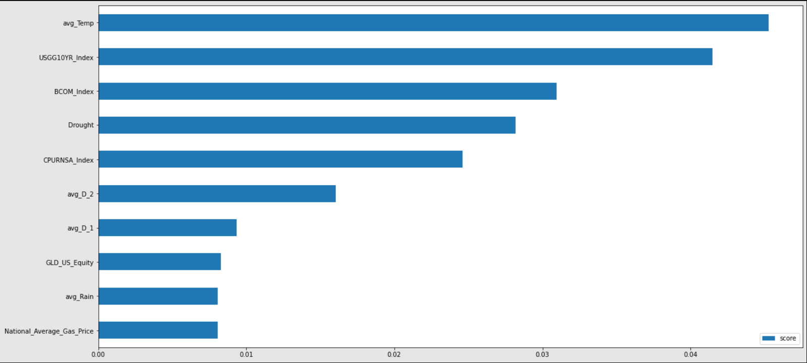
06
Plot of feature importance: Apple & Tomato
Forecasting
The gain type shows the average gain across all splits where feature was used.
A higher value of this metric when compared to another feature implies it is more important for generating a prediction.
35

Slide 36
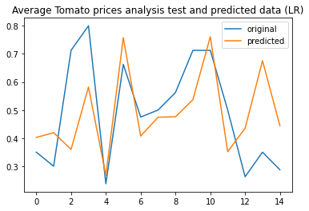
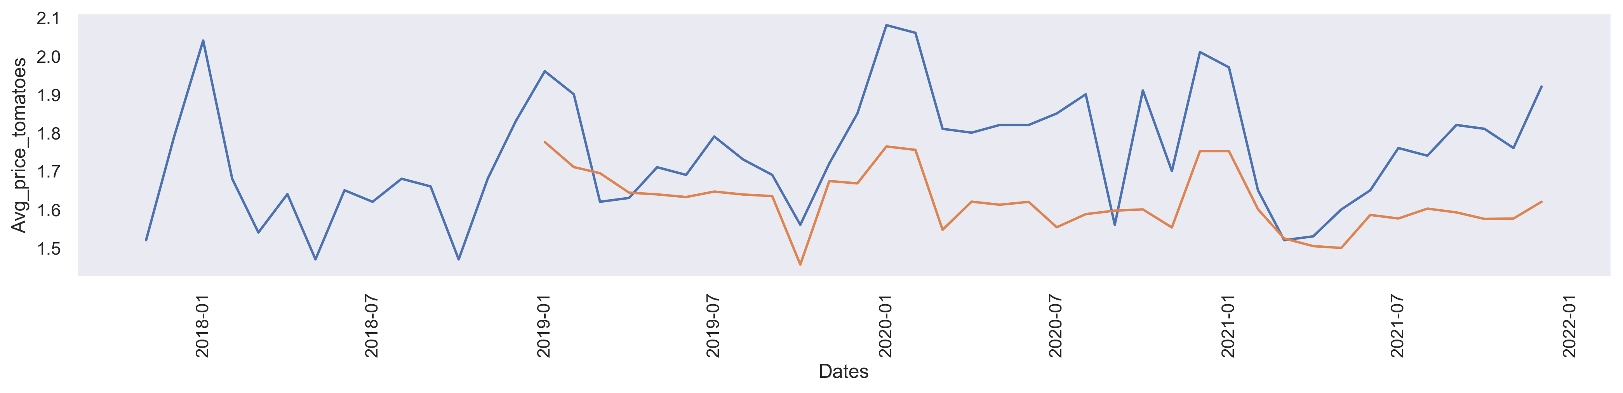
06
Forecast Future Prices
Forecasting
Using just historical stock prices, historical weather data, and drought data our model can predict the retail price of apples and tomatoes with only about a small error. (15-cent difference on average)
This model can be used for future forecasting of prices of multiple agricultural commodities
This model is highly versatile, exchanging historical USDA retail price data with local food retail price data, we can reasonably predict the prices of foods on the local level in the possible future​
Discussion
With further parameter tuning and the adding of more indicators, we can bring the margin of error lower
One key prospect in the future is to add weather data specific to where that commodity was grown, for example adding historical weather data from Washington or New York to find the correlation in how weather from those producer regions can directly impact the price of that commodity to the consumer

Slide 37
Next Steps....
Online Grocery sites(Walmart/Hy-Vee)
Pictures from farmer’s market
Producers
Web Scraping
Price Extraction using Computer Vision
Tool/excel sheets(send monthly to collect data from producers)
Python Scheduler to run every week
Raw Data (cloud Database)
Python Script
Data cleaning /manipulation
Remove Outliers
Cleaned Data
Notes:
Also mention challenges:
Lack of data

